Slide 1
Unit 2: Stack and Its application Alish K.C. Lecturer Xavier International College

Slide 2



Slide 3
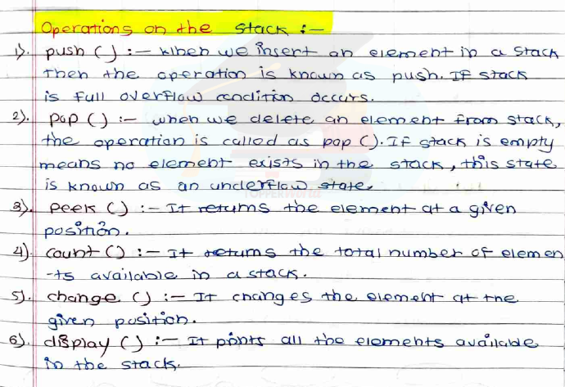

Slide 4
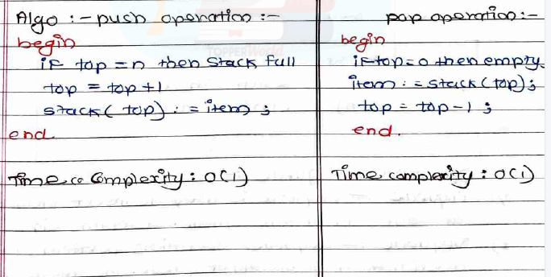

Slide 5
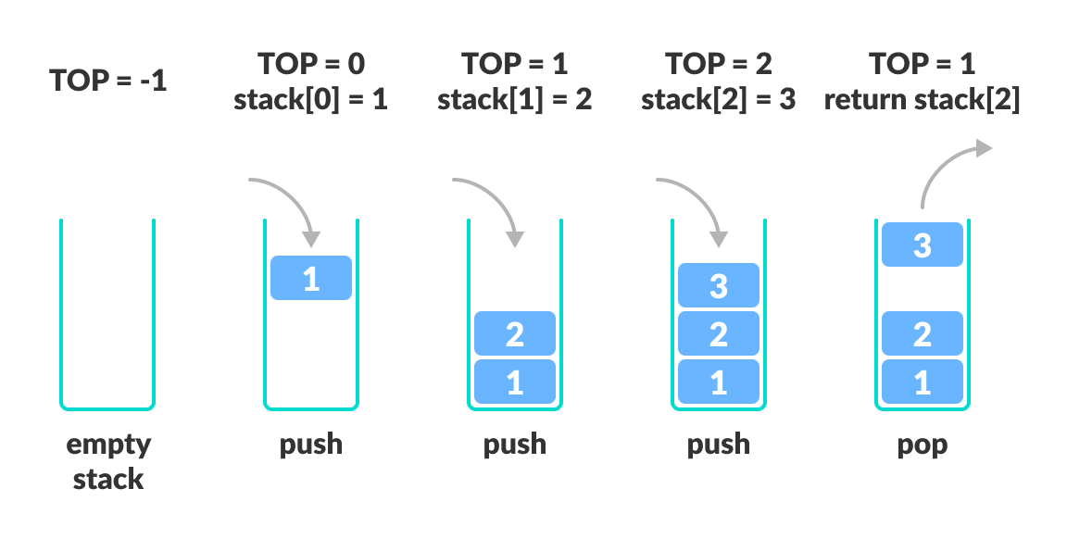

Slide 6

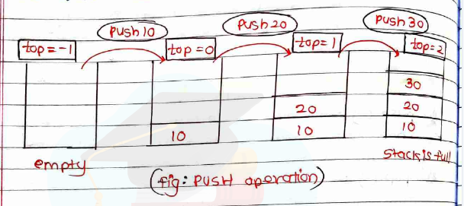
Push operation

Slide 7


Pop operation

Slide 8
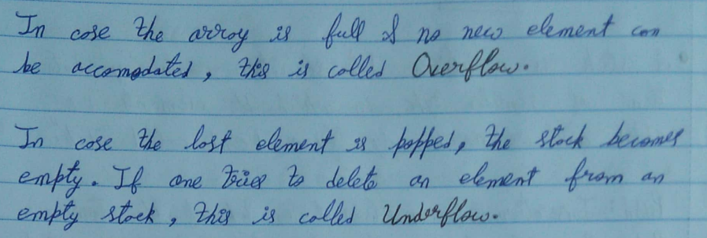

Slide 9
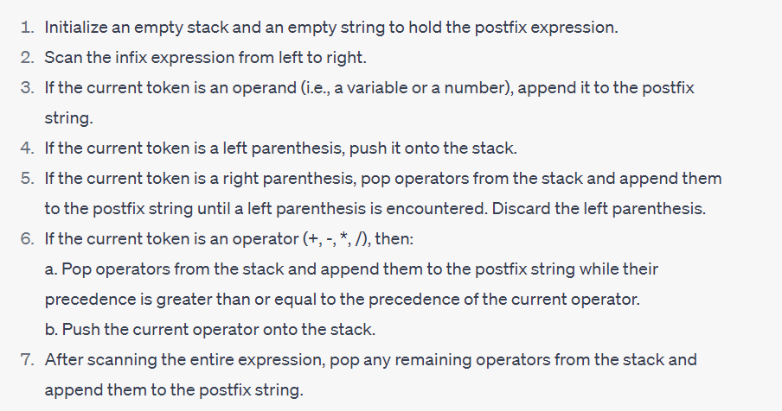
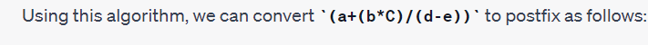

Slide 10
Thank You

